Slide 1
Roadmap
Overview
File organisation and Access
File Directories
File Sharing
Record Blocking
Secondary Storage Management
File System Security
Unix File Management
Linux Virtual File System
Windows File System
Notes:
We begin with an overview, followed by a look at various file organization schemes.
Although file organization is generally beyond the scope of the operating system, it is essential to have a general understanding of the common alternatives to appreciate some of the design tradeoffs involved in file management.
The remainder of this chapter looks at other topics in file management.
<number>

Slide 2
Files
Files are the central element to most applications
The File System is one of the most important part of the OS to a user
Desirable properties of files:
Long-term existence
Sharable between processes
Structure
Notes:
In most applications, the file is the central element.
From the user’s point of view, one of the most important parts of an operating system is the file system.
The file system provides the resource abstractions typically associated with secondary storage.
Desirable properties include
Long-term existence: Files are stored on disk or other secondary storage and do not disappear when a user logs off.
Sharable between processes: Files have names and can have associated access permissions that permit controlled sharing.
Structure: Depending on the file system, a file can have an internal structure that is convenient for particular applications. In addition, files can be organized into hierarchical or more complex structure to reflect the relationships among files.
<number>

Slide 3
File Management
File management system consists of system utility programs that run as privileged applications
Concerned with secondary storage
Notes:
<number>

Slide 4
Typical Operations
File systems also provide functions which can be performed on files, typically:
Create
Delete
Open
Close
Read
Write
Notes:
Any file system provides not only a means to store data organized as files, but a collection of functions that can be performed on files.
Typical operations include the following:
Create: A new file is defined and positioned within the structure of files.
Delete: A file is removed from the file structure and destroyed.
Open: An existing file is declared to be “opened” by a process, allowing the process to perform functions on the file.
Close: The file is closed with respect to a process, so that the process no longer may perform functions on the file, until the process opens the file again.
Read: A process reads all or a portion of the data in a file.
Write: A process updates a file, either by adding new data that expands the size of the file or by changing the values of existing data items in the file.
<number>

Slide 5
Objectives for a File Management System
Meet the data management needs of the user
Guarantee that the data in the file are valid
Optimize performance
Provide I/O support for a variety of storage device types
Minimize lost or destroyed data
Provide a standardized set of I/O interface routines to user processes
Provide I/O support for multiple users (if needed)
Notes:
Objectives include:
To meet the data management needs and requirements of the user,
To guarantee, to the extent possible, that the data in the file are valid
To optimize performance, both from the system point of view in terms of over-all throughput and from the user’s point of view in terms of response time
To provide I/O support for a variety of storage device types
To minimize or eliminate the potential for lost or destroyed data
To provide a standardized set of I/O interface routines to user processes
To provide I/O support for multiple users, in the case of multiple-user systems
<number>

Slide 6
Requirements for a
general purpose system
Each user should be able to create, delete, read, write and modify files
Each user may have controlled access to other users’ files
Each user may control what type of accesses are allowed to the users’ files
Each user should be able to restructure the user’s files in a form appropriate to the problem
Notes:
For an interactive, general-purpose system, the following constitute a minimal set of requirements:
1. Each user should be able to create, delete, read, write, and modify files.
2. Each user may have controlled access to other users’ files.
3. Each user may control what types of accesses are allowed to the user’s files.
4. Each user should be able to restructure the user’s files in a form appropriate to the problem.
5,6, and 7 on next slide
<number>

Slide 7
Requirements cont.
Each user should be able to move data between files
Each user should be able to back up and recover the user’s files in case of damage
Each user should be able to access the user’s files by using symbolic names
Notes:
5. Each user should be able to move data between files.
6. Each user should be able to back up and recover the user’s files in case of damage.
7. Each user should be able to access his or her files by name rather than by numeric identifier.
<number>

Slide 8
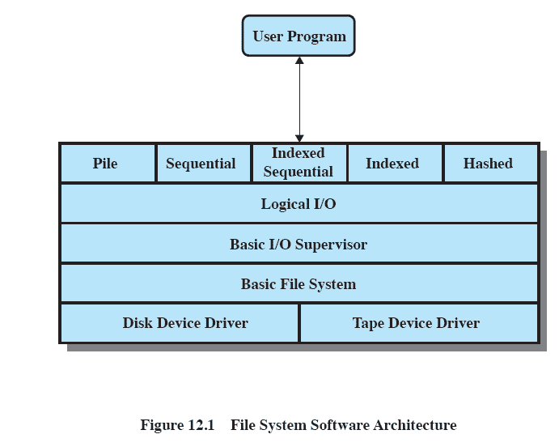
Typical software
organization
Notes:
Variations will exist between systems but typically have the aspects described above and in the following slides
<number>

Slide 9
Device Drivers
Lowest level
Communicates directly with peripheral devices
Responsible for starting I/O operations on a device
Processes the completion of an I/O request
Notes:
device drivers communicate at the lowest level directly with peripheral devices or their controllers or channels.
A device driver is responsible for starting I/O operations on a device and processing the completion of an I/O request.
For file operations, the typical devices controlled are disk and tape drives.
Device drivers are usually considered to be part of the operating system.
<number>

Slide 10
Basic File System
Physical I/O
Primary interface with the environment outside the computer system
Deals with exchanging blocks of data
Concerned with the placement of blocks
Concerned with buffering blocks in main memory
Notes:
basic file system, or the physical I/O level.
This is the primary interface with the environment outside of the computer system.
It deals with blocks of data that are exchanged with disk or tape systems.
It is concerned with the placement of those blocks on the secondary storage device and on the buffering of those blocks in main memory.
It does not understand the content of the data or the structure of the files involved.
The basic file system is often considered part of the operating system.
<number>

Slide 11
Basic I/O Supervisor
Responsible for all file I/O initiation and termination.
Control structures deal with
Device I/O,
Scheduling,
File status.
Selects and schedules I/O with the device
Notes:
Basic I/O supervisor is responsible for all file I/O initiation and termination.
Control structures are maintained that deal with
device I/O,
scheduling, and
file status.
The basic I/O supervisor selects the device on which file I/O is to be performed, based on the particular file selected.
It is also concerned with scheduling disk and tape accesses to optimize performance.
I/O buffers are assigned and secondary memory is allocated at this level.
The basic I/O supervisor is part of the operating system.
<number>

Slide 12
Logical I/O
Enables users and applications to access records
Provides general-purpose record I/O capability
Maintains basic data about file
Notes:
Logical I/O enables users and applications to access records.
Whereas the basic file system deals with blocks of data,
the logical I/O module deals with file records.
Logical I/O provides a general-purpose record I/O capability
and maintains basic data about files.
<number>

Slide 13
Access Method
Closest to the user
Reflect different file structures
Provides a standard interface between applications and the file systems and devices that hold the data
Access method varies depending on the ways to access and process data for the device.
Notes:
the access method is the level of the file system closest to the user.
It provides a standard interface between applications and the file systems and devices that hold the data.
Different access methods reflect different file structures and different ways of accessing and processing the data.
<number>

Slide 14
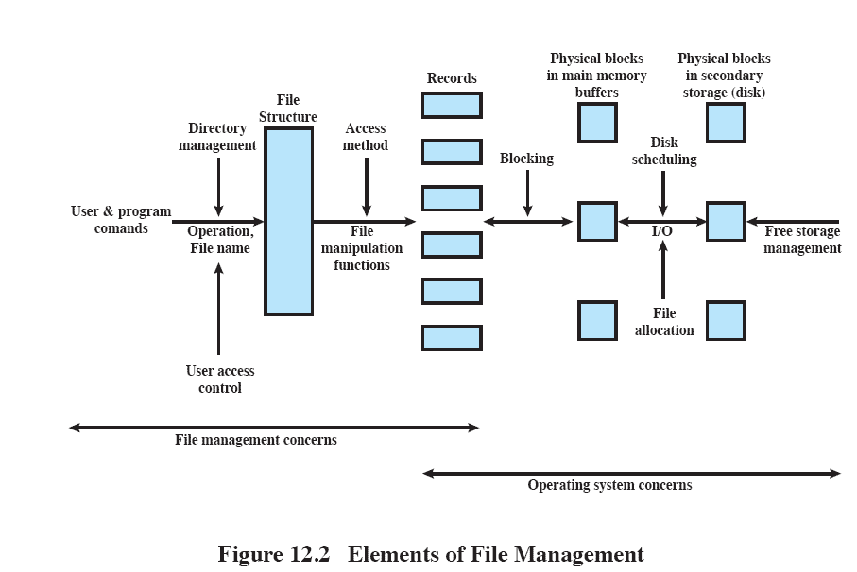
Elements of
File Management
Notes:
Users and application programs interact with the file system by means of commands for creating and deleting files and for performing operations on files.
Before performing any operation, the file system must identify and locate the selected file.
This requires the use of some sort of directory that serves to describe the location of all files, plus their attributes.
In addition, most shared systems enforce user access control
The basic operations that a user or application may perform on a file are performed at the record level.
The user or application views the file as having some structure that organizes the records, such as a sequential structure
The secondary storage must be managed.
This involves allocating files to free blocks on secondary storage and managing free storage so as to know what blocks are available for new files and growth in existing files.
In addition, individual block I/O requests must be scheduled
Disk scheduling and file allocation are both concerned with optimizing performance.
The optimization will depend on the structure of the files and the access patterns.
<number>

Slide 15
Roadmap
Overview
File organisation and Access
File Directories
File Sharing
Record Blocking
Secondary Storage Management
File System Security
Unix File Management
Linux Virtual File System
Windows File System
Notes:
<number>

Slide 16
File Organization
File Management Referring to the logical structure of records
Physical organization discussed later
Determined by the way in which files are accessed
Notes:
“file organization” refers to the logical structuring of the records as determined by the way in which they are accessed.
<number>

Slide 17
Criteria for
File Organization
Important criteria include:
Short access time
Ease of update
Economy of storage
Simple maintenance
Reliability
Priority will differ depending on the use (e.g. read-only CD vs Hard Drive)
Some may even conflict
Notes:
The relative priority of these criteria will depend on the applications that will use the file.
e.g. if a file is only to be processed in batch mode, with all of the records accessed every time, then rapid access for retrieval of a single record is of minimal concern.
A file stored on CD-ROM will never be updated, and so ease of update is not an issue.
These criteria may conflict.
E.g. for economy of storage, there should be minimum redundancy in the data, but redundancy is a primary means of increasing the speed of access to data (such as indexes.)
<number>

Slide 18
File Organisation
Types
Many exist, but usually variations of:
Pile
Sequential file
Indexed sequential file
Indexed file
Direct, or hashed, file
Notes:
Most structures used in actual systems either fall into one of these categories or can be implemented with a combination of these organizations.
The five organizations are:
The pile
The sequential file
The indexed sequential file
The indexed file
The direct, or hashed, file
<number>

Slide 19
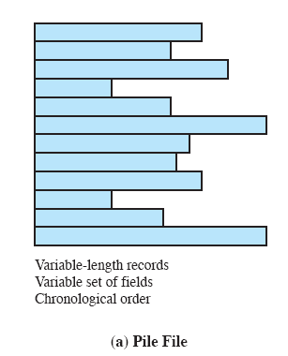
The Pile
Data are collected in the order they arrive
No structure
Purpose is to accumulate a mass of data and save it
Records may have different fields
Record access is by exhaustive search
Notes:
The least-complicated form of file organization may be termed the pile.
Data are collected in the order in which they arrive.
Each record consists of one burst of data.
The purpose of the pile is simply to accumulate the mass of data and save it.
Records may have different fields, or similar fields in different orders.
Thus, each field should be self-describing, including a field name as well as a value.
The length of each field must be implicitly indicated by delimiters.
Because there is no structure to the pile file, record access is by exhaustive search.
ie , to find a record that contains a particular field with a particular value, it is necessary to examine each record in the pile until the desired record is found or the entire file has been searched.
to find all records that contain a particular field or contain that field with a particular value, then the entire file must be searched.
<number>

Slide 20
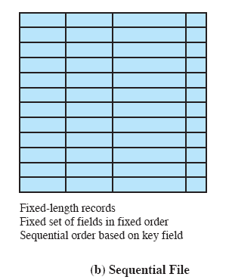
The Sequential File
Fixed format used for records
Records are the same length
All fields the same (order and length)
Field names and lengths are attributes of the file
Key field
Uniquely identifies the record
Records are stored in key sequence
Notes:
The most common form of file structure.
A fixed format is used for records.
All records are of the same length, consisting of the same number of fixed-length fields in a particular order.
Because the length and position of each field are known, only the values of fields need to be stored;
the field name and length for each field are attributes of the file structure.
The key field uniquely identifies the record;
thus key values for different records are always different.
The records are stored in key sequence: alphabetical order for a text key, and numerical order for a numerical key.
<number>

Slide 21
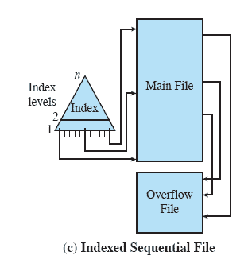
Indexed Sequential File
Maintains the key characteristic of the sequential file:
records are organized in sequence based on a key field.
Two features are added:
an index to the file to support random access,
and an overflow file.
Notes:
The indexed sequential file maintains the key characteristic of the sequential file:
records are organized in sequence based on a key field.
Two features are added:
an index to the file to support random access,
and an overflow file.
The index provides a lookup capability to reach quickly the vicinity of a desired record.
The overflow file is similar to the log file used with a sequential file
but is integrated so that a record in the overflow file is located by following a pointer from its predecessor record.
<number>

Slide 22
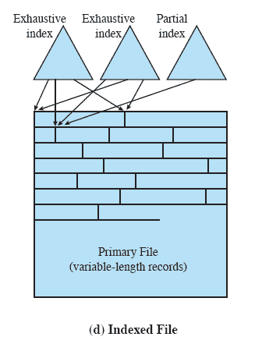
Indexed File
Uses multiple indexes for different key fields
May contain an exhaustive index that contains one entry for every record in the main file
May contain a partial index
When a new record is added to the main file, all of the index files must be updated.
Notes:
In the general indexed file, the concept of sequentiality and a single key are abandoned.
Records are accessed only through their indexes.
now no restriction on the placement of records as long as a pointer in at least one index refers to that record.
variable-length records can be employed.
Two types of indexes are used.
An exhaustive index contains one entry for every record in the main file. The index itself is organized as a sequential file for ease of searching.
A partial index contains entries to records where the field of interest exists.
When a new record is added to the main file, all of the index files must be updated.
<number>

Slide 23
File Organization
Access directly any block of a known address.
The Direct or Hashed File
Directly access a block at a known address
Key field required for each record
Notes:
Exploits the capability found on disks to access directly any block of a known address.
A key field is required in each record.
But there is no concept of sequential ordering.
The direct file makes use of hashing on the key value.
Direct files are often used where very rapid access is required, where fixed length records are used, and where records are always accessed one at a time.
<number>

Slide 24
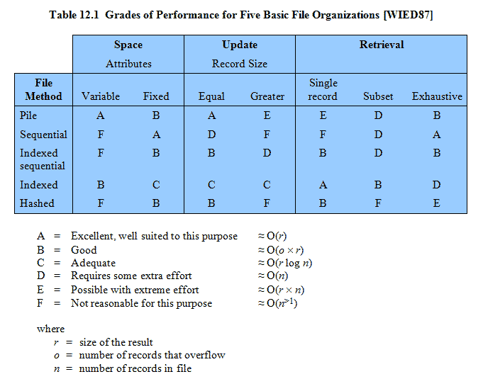
Performance
Notes:
<number>

Slide 25
Roadmap
Overview
File organisation and Access
File Directories
File Sharing
Record Blocking
Secondary Storage Management
File System Security
Unix File Management
Linux Virtual File System
Windows File System
Notes:
<number>

Slide 26
Blocks and records
Records are the logical unit of access of a structured file
But blocks are the unit for I/O with secondary storage
Three approaches are common
Fixed length blocking
Variable length spanned blocking
Variable-length unspanned blocking
Notes:
Records are the logical unit of access of a structured file,
Whereas blocks are the unit of I/O with secondary storage. For I/O to be performed,
records must be organized as blocks.
<number>

Slide 27
Fixed Blocking
Fixed-length records are used, and an integral number of records are stored in a block.
Unused space at the end of a block is internal fragmentation
Notes:
Fixed blocking: Fixed-length records are used, and an integral number of records are stored in a block.
There may be unused space at the end of each block.
This is referred to as internal fragmentation.
<number>

Slide 28
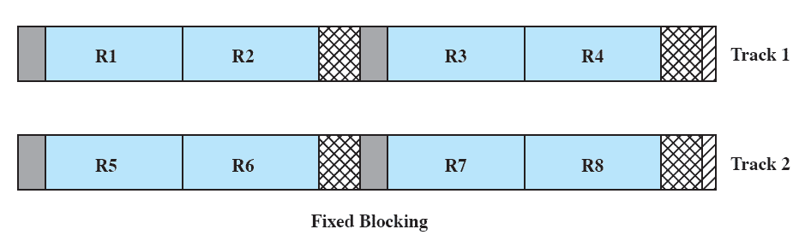
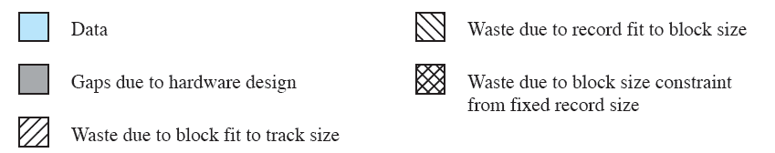
Fixed Blocking
Notes:
<number>

Slide 29
Variable Length
Spanned Blocking
Variable-length records are used and are packed into blocks with no unused space.
Some records may span multiple blocks
Continuation is indicated by a pointer to the successor block
Notes:
Variable-length records are used and are packed into blocks with no unused space.
Thus, some records must span two blocks, with the continuation indicated by a pointer to the successor block.
<number>

Slide 30
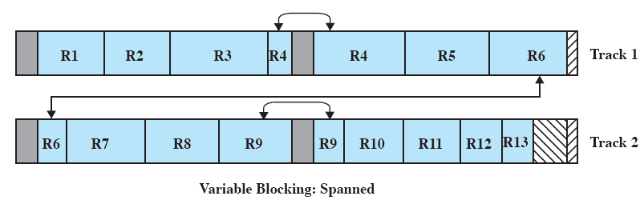
Variable Blocking:
Spanned
Notes:
<number>

Slide 31
Variable-length
unspanned blocking
Uses variable length records without spanning
Wasted space in most blocks because of the inability to use the remainder of a block if the next record is larger than the remaining unused space.
Notes:
Variable-length records are used, but spanning is not employed.
There is wasted space in most blocks because of the inability to use the remainder of a block if the next record is larger than the remaining unused space.
<number>

Slide 32
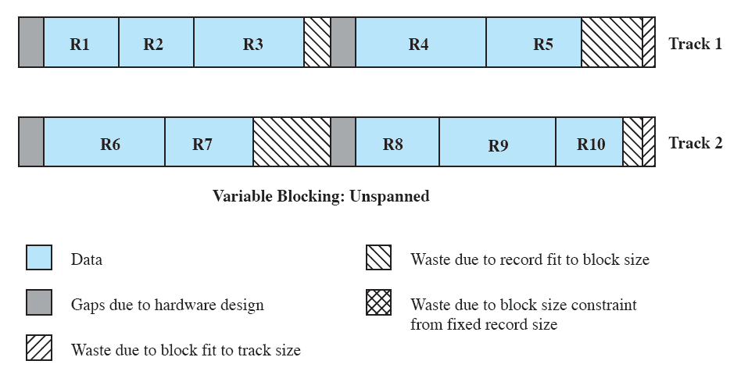
Variable Blocking:
Unspanned
Notes:
<number>

Slide 33
Roadmap
Overview
File organisation and Access
File Directories
File Sharing
Record Blocking
Secondary Storage Management
File System Security
Unix File Management
Linux Virtual File System
Windows File System
Notes:
<number>

Slide 34
Secondary Storage Management
The Operating System is responsible for allocating blocks to files
Two related issues
Space must be allocated to files
Must keep track of the space available for allocation
Notes:
On secondary storage, a file consists of a collection of blocks.
The operating system or file management system is responsible for allocating blocks to files.
This raises two management issues.
First, space on secondary storage must be allocated to files,
second, it is necessary to keep track of the space available for allocation.
<number>

Slide 35
File allocation issues
When a file is created – is the maximum space allocated at once?
Space is added to a file in contiguous ‘portions’
What size should be the ‘portion’?
What data structure should be used to keep track of the file portions?
Notes:
When a new file is created, is the maximum space required for the file allocated at once?
2. Space is allocated to a file as one or more contiguous units, which we shall refer to as portions.
That is, a portion is a contiguous set of allocated blocks.
The size of a portion can range from a single block to the entire file.
What size of portion should be used for file allocation?
3. What sort of data structure or table is used to keep track of the portions assigned to a file?
An example of such a structure is a file allocation table (FAT), found on DOS and some other systems.
<number>

Slide 36
Preallocation vs
Dynamic Allocation
Need the maximum size for the file at the time of creation
Difficult to reliably estimate the maximum potential size of the file
Tend to overestimated file size so as not to run out of space
Notes:
A preallocation policy requires that the maximum size of a file be declared at the time of the file creation request.
Sometimes such as program compilations, the production of summary data files, or the transfer of a file from another system over a communications network, this value can be reliably estimated.
But usually it is difficult if not impossible to estimate reliably the maximum potential size of the file.
In those cases, users and application programmers would tend to overestimate file size, leading to wasted space
Thus, there are advantages to the use of dynamic allocation, which allocates space to a file in portions as needed.
<number>

Slide 37
Portion size
Two extremes:
Portion large enough to hold entire file is allocated
Allocate space one block at a time
Trade-off between efficiency from the point of view of a single file, or the overall system efficiency
Notes:
At one extreme, a portion large enough to hold the entire file is allocated.
Space on the disk is allocated one block at a time.
In choosing a portion size, there is a tradeoff between efficiency from the point of view of a single file versus overall system efficiency.
<number>

Slide 38
File Allocation Method
Three methods are in common use:
contiguous,
chained, and
indexed.

Slide 39
Contiguous Allocation
Single set of blocks is allocated to a file at the time of creation
Only a single entry in the file allocation table
Starting block and length of the file
External fragmentation will occur
Need to perform compaction
Notes:
A single contiguous set of blocks is allocated to a file at the time of file creation
This is a preallocation strategy, using variable-size portions.
The file allocation table needs just a single entry for each file, showing the starting block and the length of the file.
Contiguous allocation is the best from the point of view of the individual sequential file.
Multiple blocks can be read in at a time to improve I/O performance for sequential processing.
It is also easy to retrieve a single block.
<number>

Slide 40
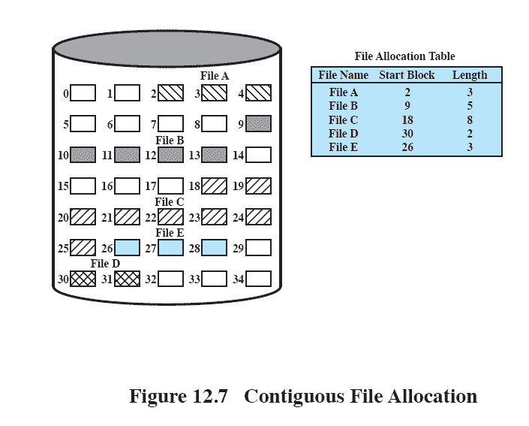
Contiguous
File Allocation
Notes:
<number>

Slide 41
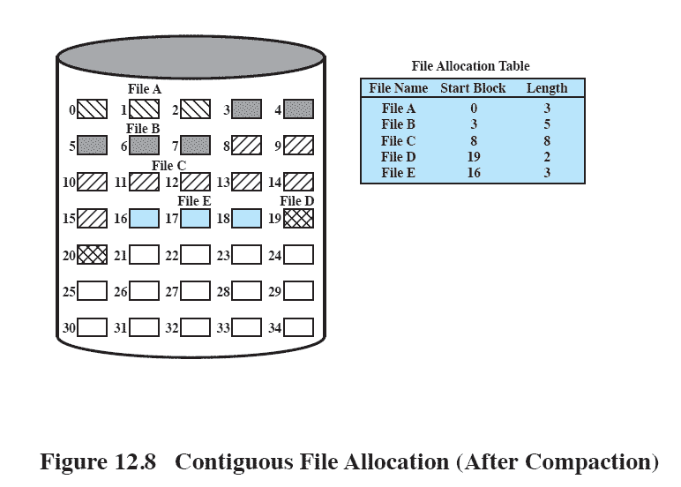
External fragmentation
Notes:
External fragmentation will occur, making it difficult to find contiguous blocks of space of sufficient length.
From time to time, it will be necessary to perform a compaction algorithm to free up additional space on the disk.
Also, with preallocation, it is necessary to declare the size of the file at the time of creation, with the problems mentioned earlier.
<number>

Slide 42
Chained Allocation
Allocation on basis of individual block
Each block contains a pointer to the next block in the chain
Only single entry in the file allocation table
Starting block and length of file
No external fragmentation
Best for sequential files
Notes:
Typically, allocation is on an individual block basis.
Each block contains a pointer to the next block in the chain.
The file allocation table needs just a single entry for each file, showing the starting block and the length of the file.
Although preallocation is possible, it is more common simply to allocate blocks as needed.
The selection of blocks is now a simple matter: any free block can be added to a chain.
There is no external fragmentation to worry about because only one block at a time is needed.
This type of physical organization is best suited to sequential files that are to be processed sequentially.
To select an individual block of a file requires tracing through the chain to the desired block.
<number>

Slide 43
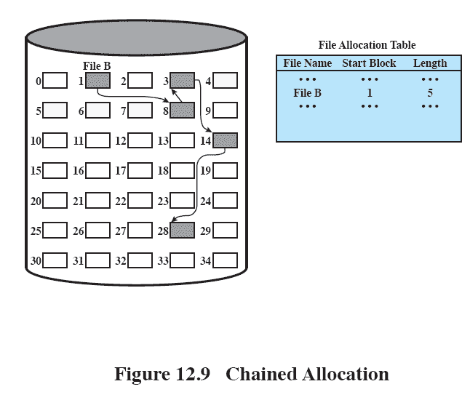
Chained Allocation
Notes:
<number>

Slide 44
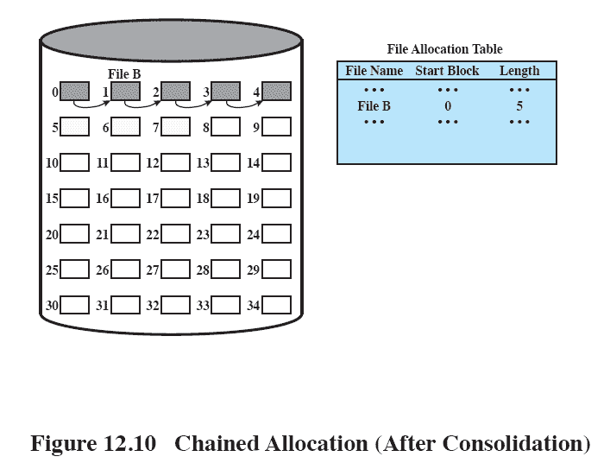
Chained Allocation Consolidation
Notes:
One consequence of chaining, is that there is no accommodation of the principle of locality.
If it is necessary to bring in several blocks of a file at a time, as in sequential processing, then a series of accesses to different parts of the disk are required.
This is perhaps a more significant effect on a single-user system but may also be of concern on a shared system.
To overcome this problem, some systems periodically consolidate files
<number>

Slide 45
Indexed Allocation
File allocation table contains a separate one-level index for each file
The index has one entry for each portion allocated to the file
The file allocation table contains block number for the index
Notes:
This addresses many of the problems of contiguous and chained allocation.
In this case, the file allocation table contains a separate one-level index for each file;
the index has one entry for each portion allocated to the file.
Typically, the file indexes are not physically stored as part of the file allocation table.
Rather, the file index for a file is kept in a separate block, and the entry for the file in the file allocation table points to that block.
<number>

Slide 46
Indexed Allocation
Method
Allocation may be either
Fixed size blocks or
Variable sized blocks
Allocating by blocks eliminates external fragmentation
Variable sized blocks improves locality
Both cases require occasional consolidation
Notes:
Allocation may be on the basis of either
fixed-size blocks or
variable-size portions
Allocation by blocks eliminates external fragmentation,
whereas allocation by variable-size portions improves locality.
In either case, file consolidation may be done from time to time.
File consolidation reduces the size of the index in the case of variable-size portions, but not in the case of block allocation.
<number>

Slide 47
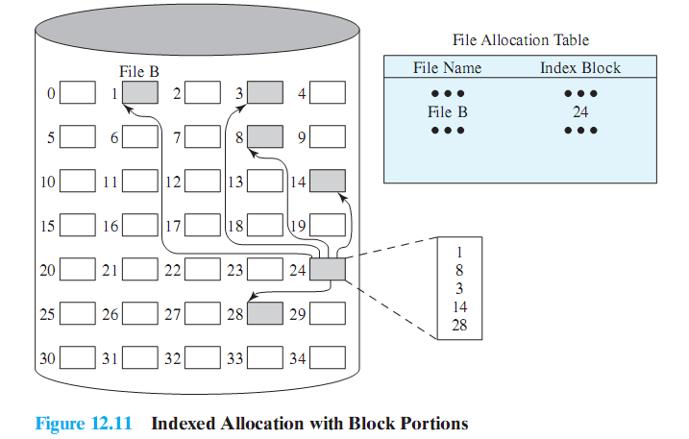
Indexed allocation
with Block Portions

Slide 48
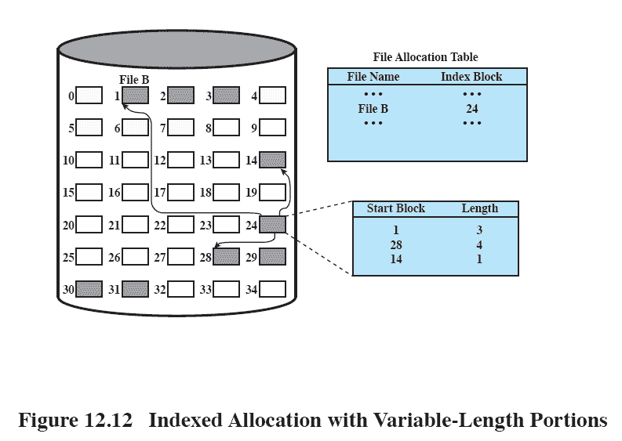
Indexed Allocation with
Variable Length Portions
Notes:
<number>

Slide 49
Free
Space Management
Just as allocated space must be managed, so must the unallocated space
To perform file allocation, we need to know which blocks are available.
We need a disk allocation table in addition to a file allocation table
Notes:
Just as the space that is allocated to files must be managed, so the space that is not currently allocated to any file must be managed.
To perform any of the file allocation techniques described previously, it is necessary to know what blocks on the disk are available.
Thus we need a disk allocation table in addition to a file allocation table.
<number>

Slide 50
Bit Tables
This method uses a vector containing one bit for each block on the disk.
Each entry of a 0 corresponds to a free block,
and each 1 corresponds to a block in use.
Advantages:
Works well with any file allocation method
Small as possible
Notes:
This method uses a vector containing one bit for each block on the disk.
Each entry of a 0 corresponds to a free block, and each 1 corresponds to a block in use.
A bit table has the advantage that it is relatively easy to find one or a contiguous group of free blocks.
Thus, a bit table works well with any of the file allocation methods outlined.
Another advantage is that it is as small as possible.
<number>

Slide 51
Chained Free Portions
The free portions may be chained together by using a pointer and length value in each free portion.
Negligible space overhead
Suited to all file allocation methods
Leads to fragmentation
Notes:
The free portions may be chained together by using a pointer and length value in each free portion.
This method has negligible space overhead because there is no need for a disk allocation table, merely for a pointer to the beginning of the chain and the length of the first portion.
This method is suited to all of the file allocation methods.
If allocation is a block at a time, simply choose the free block at the head of the chain and adjust the first pointer or length value.
If allocation is by variable-length portion, a first-fit algorithm may be used: The headers from the portions are fetched one at a time to determine the next suitable free portion in the chain. Again, pointer and length values are adjusted.
This method has its own problems.
After some use, the disk will become quite fragmented and many portions will be a single block long.
Also note that every time you allocate a block, you need to read the block first to recover the pointer to the new first free block before writing data to that block. If many individual blocks need to be allocated at one time for a file operation, this greatly slows file creation
Similarly, deleting highly fragmented files is very time consuming.
<number>

Slide 52
Indexing
treats free space as a file and uses an index table as it would for file allocation
For efficiency, the index should be on the basis of variable-size portions rather than blocks.
Thus, there is one entry in the table for every free portion on the disk.
This approach provides efficient support for all of the file allocation methods.
Notes:
The indexing approach treats free space as a file and uses an index table as described under file allocation.
For efficiency, the index should be on the basis of variable-size portions rather than blocks.
Thus, there is one entry in the table for every free portion on the disk.
This approach provides efficient support for all of the file allocation methods.
<number>

Slide 53
Free Block List
Each block is assigned a number sequentially
the list of the numbers of all free blocks is maintained in a reserved portion of the disk.
Notes:
In this method, each block is assigned a number sequentially and the list of the numbers of all free blocks is maintained in a reserved portion of
the disk.
Depending on the size of the disk, either 24 or 32 bits will be needed to store a single block number, so the size of the free block list is 24 or 32 times the size of the corresponding bit table and thus must be stored on disk rather than in main memory.
<number>

Slide 54
Volumes
A collection of addressable sectors in secondary memory that an OS or application can use for data storage.
The sectors in a volume need not be consecutive on a physical storage device;
instead they need only appear that way to the OS or application.
A volume may be the result of assembling and merging smaller volumes.
Notes:
The term volume is used somewhat differently by different operating systems and file management systems, but in essence a volume is a logical disk.
<number>

Slide 55
Roadmap
Overview
File organisation and Access
File Directories
File Sharing
Record Blocking
Secondary Storage Management
File System Security
Unix File Management
Linux Virtual File System
Windows File System
Notes:
<number>

Slide 56
Access Control
By successfully logging on to a system, the user is identified
The OS can then enforce rules
Granting access to files and applications (or denying)
The OS needs a rule-set to enforce
Notes:
Following successful logon, the user has been granted access to one or a set of hosts and applications.
Through the user access control procedure, a user can be identified to the system.
Associated with each user, there can be a profile that specifies permissible operations and file accesses.
The operating system can then enforce rules based on the user profile.
<number>

Slide 57
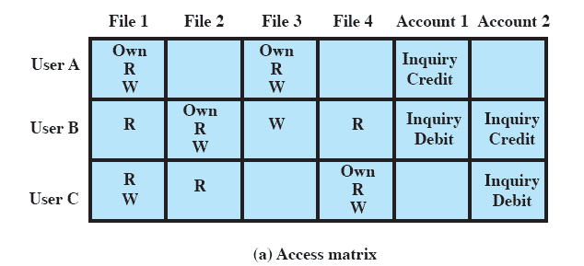
Access Matrix
One such rule set is an Access Matrix
Notes:
One dimension of the matrix consists of identified subjects that may attempt data access.
Typically, this list will consist of individual users or user groups, although access could be controlled for terminals, hosts, or applications instead of or in addition to users.
The other dimension lists the objects that may be accessed.
At the greatest level of detail, objects may be individual data fields.
More aggregate groupings, such as records, files, or even the entire database, may also be objects in the matrix.
Each entry in the matrix indicates the access rights of that subject for that object.
<number>

Slide 58
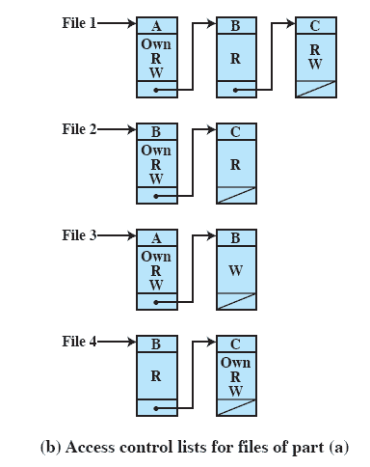
Access Control Lists
A matrix may be decomposed by columns
Giving an Access Control List (ACL) for each file.
Notes:
In practice, an access matrix is usually sparse and is implemented by decomposition in one of two ways. The matrix may be decomposed by columns, yielding access control lists
Thus for each object, an access control list lists users and their permitted access rights.
The access control list may contain a default, or public, entry.
This allows users that are not explicitly listed as having special rights to have a default set of rights.
Elements of the list may include individual users as well as groups of users.
<number>

Slide 59
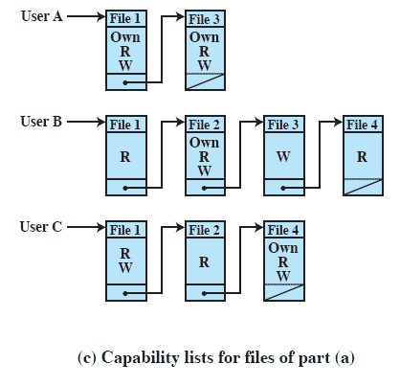
Capability Lists
Decomposition by rows yields capability lists (or ticket)
specifies authorized objects and operations for a user.
Notes:
Decomposition by rows yields capability tickets
A capability ticket specifies authorized objects and operations for a user.
Each user has a number of tickets and may be authorized to loan or give them to others.
Because tickets may be dispersed around the system, they present a greater security problem than access control lists.
In particular, the ticket must be unforgeable.
<number>

